Slide 1
Decumulation in a mandatory DC pension environment
John Piggott
University of New South Wales

Slide 2
Outline of talk
Demographics
Market developments
What do people want?
How can this be delivered?
Policy designs – some specific country examples
Future trends and new products

Slide 3
Increasing longevity

Slide 4
Survival probability to age 90 for at least one member of couple: Australia, Male 65/Female 60
Source: Authors’ calculation based on mortality rates and 100-year improvement factors reported in Australian Life Table 2000-02.

Slide 5
Population aged 65 and over, by region (millions)
Notes:
This table gives some visual weight to the three issues mentioned on the previous slide.
Source: World Bank, 1994:World Population Projections

Slide 6
Old-age dependency ratios 2005, 2050

Slide 7
Trends in the Market
Policy:
Withdrawal of PAYG
More reliance on mandatory DC
Private sector pensions :
DB ➔ DC
Private insurance:
Lump sums
Phased withdrawals
Reverse mortgages

Slide 8
Implications of govt and market shift
Risk sharing is now much more limited
Private sector:
Investment ➔ individual account, no inter-cohort smoothing
Longevity/health ➔ no post employment attachment
Government:
Demographic shift ➔ Concerns with fiscal pressure are more important
➔ Less inter-generational risk-sharing

Slide 9
Recent International Growth of mandatory DC schemes
1981 – Chile
1985 – Switzerland; Netherlands
1986-92 – Australia
1993 – Argentina*; Columbia*, Denmark, Peru
1996 – Uruguay
1998 – Hungary; Kazakhstan; Bolivia; Mexico
1999 – El Salvador; Poland
2000 – Hong Kong; Sweden
2001 – Latvia
2003 – Dominican Republic
439 million people potentially affected since 1980
India now has compulsory DC schemes for state employees
China is playing with the idea
*Not strictly compulsory
Notes:
Show that many countries are making the transition to fully funded systems; Indian government employees now contribute to DC schemes, and optional for employees of small private sector firms; 439 million is simply the total population of the countries listed here; Other countries in various stages of moving towards mandatory DC schemes include Romania, Venezuela, Costa Rica, Croatia, Macedonia, and Nicaragua.
Source: your book, and my searching on the internet

Slide 10

Benefit Design
U.S. Health and Retirement Study 1992-2000, with over 12 000 respondents
69% of those who rely on DB pensions are happy with their retirement; only 54% without annuity income
After 10 years of retirement, those with annuity incomes are 45% more likely to be ‘very satisfied’
Retirees with annuity income streams are 30% more likely to have no depression symptoms
Source: Panis (2003)
Notes:
It’s a good idea to have a flick over the tables in this Panis study, so that you know all the qualifications and caveats surrounding these percentages etc. It’s only a short article.
Annuities are best. But …
People avoid annuities, despite their inherent welfare-enhancing properties
Insurance companies reluctant to supply annuities
What do you do with small accumulations?

Slide 11
Dealing with it: traditional response
Personal resources: fail to save, early retirement, no insurance, wealth locked in the family home.
Family resources: the child as your pension
BUT – less children.
Working longer: a “natural” solution for longevity adjustment
BUT – doesn’t cope with fertility decline
Social security: usually defined benefit schemes. Many are under-funded, implying fiscal stress.
Occupational pension plans: Many DB plans are insolvent or under stress

Slide 12
Dealing with it: Product response
Save (or be forced to save) for your own retirement. Then take a lump sum or buy:
Life annuities
Phased withdrawals
Guaranteed minimum income annuities
Other products:
Reverse mortgages
LTC insurance

Slide 13
Components of Retirement Provision
Universal
SAFETY
NET
Targeted
PAYG
Publicly provided
COMPULSORY
EMPLOYMENT
RELATED
Funded
Privately managed
Privately provided
Publicly managed
Employment related
VOLUNTARY
SAVING
Tax preferred
Other
Non tax preferred (private saving)
Notes:
Here need to briefly overview the three tiers to give audience background and context: that is, we are concerned mainly about the second tier today (??), particularly the movement to publicly mandated rather than publicly provided retirement schemes, and the best way to implement this former strategy.

Slide 14
Components of Retirement Provision
PAYG
Publicly provided
Funded
COMPULSORY
EMPLOYMENT
RELATED
Privately managed
Privately provided
Publicly managed
Notes:
New WB paper has 5 pillars: the public PAYG is the 4th; and ancillary support (health, in-home care, long term care) is the 5th.

Slide 15

International Experience Australia
1986 Accord: compulsory saving arose as part of union wage deal
Superannuation Guarantee Act 1992
9% of earnings, phased in to 2002: employer mandate
Around 90% of Australia’s workforce is covered
Administered in the private sector
No restrictions on form of payout
Notes:
Overview and discussion of Australia’s system here

Slide 16
First Pillar: Targeted Age Pension
Eligibility age of 65, for men, moving to 65 for women
Available regardless of work history
Flat rate, but means tested
High take-up: 75 -80% get some pension, 50% get full pension
Set at 25% of average male full-time earnings for singles, 40% for married couples

Slide 17
Second Pillar: the Superannuation Guarantee
Funding
Fully funded (9% of earnings)
Individual accounts
Few investment restrictions
Coverage
High for employees
Self employed not covered

Slide 18
Features of the Superannuation Guarantee
Accumulation regulations
Defined contribution
Fully vested, preserved, portable
Preservation age 55, moving to 60.
No early withdrawals
Benefits
No income stream requirement on payout

Slide 19
Policy Development Status
 | Financing | Decumulation
First pillar (unfunded) | General tax revenue | Age pension
Second pillar (funded) | Super Guarantee contributions | ?

Slide 20
Policy Development Status
No inter-pillar co-ordination
Access ages differ between pillars
Means test treatment of superannuation drawdown inconsistent
Tax treatment inconsistent
No inter-agency co-ordination
Taxation office (ATO), Prudential authority (APRA), Social Security (FaHCSIA) have no common objective with retirement drawdowns

Slide 21
Lump sums and policy
Lump sums preferred until 2007
Tax-free threshold now >$100,000
But since 2005:
Transition to retirement legislation ➔ benefits taken as income accessed while still working and contributing
2007: Tax-free benefits for 60+ ➔ better to leave your money behind the super veil

Slide 23
Available products (Australia)
Phased withdrawals
Account-based pensions have minimum drawdown only
Life annuities
Short term-certain annuities
Long term (life expectancy) annuities
On the radar:
GMIAs

Slide 24
What is still missing?
Most longevity insurance products under-produced
Products which allow investment risk exposure combined with longevity insurance
Opportunities for accessing home equity
LTC insurance almost zero
Evidence based regulation

Slide 25
Current debates in Australia
Should there be a higher mandatory contribution rate?
Should there be a “late-life” mandatory annuity?
Should the first pillar be “buy-able”?
Should earnings tests be relaxed on the age pension?
Super funds in drawdown activity

Slide 26

International Experience Chile
Transfer to full privatisation in 1981
Compulsory for all workers – but poor compliance
10% of wages invested in private accumulation accounts
Regulated investment choice
Government guarantees annual returns (in range)
Administered in private sector by AFPs
Indexed annuity or phased withdrawal only
Notes:
Accumulated $36 in assets (2001); no obligation for AFPs to buy government securities; criticised for high administration costs, since fees/commissions are mandated to be a fixed proportion of workers contributions regardless of size; and the average real rate of return has been 10.9 percent per year; return cannot be less than 2 per cent below the median return over the past 12 months.
Sources: various, including: http://www.cato.org/testimony/ct-jr073101.html#2

Slide 27
Some points about Chile
Contribution rate not debated
Elaborate drawdown policy e.g., early retirement requires indexed life annuity at a level to keep you off social pension
Annuity design includes reversion for spouse
Major issue around participation
Big problem with fees and commissions, now regulated

Slide 28
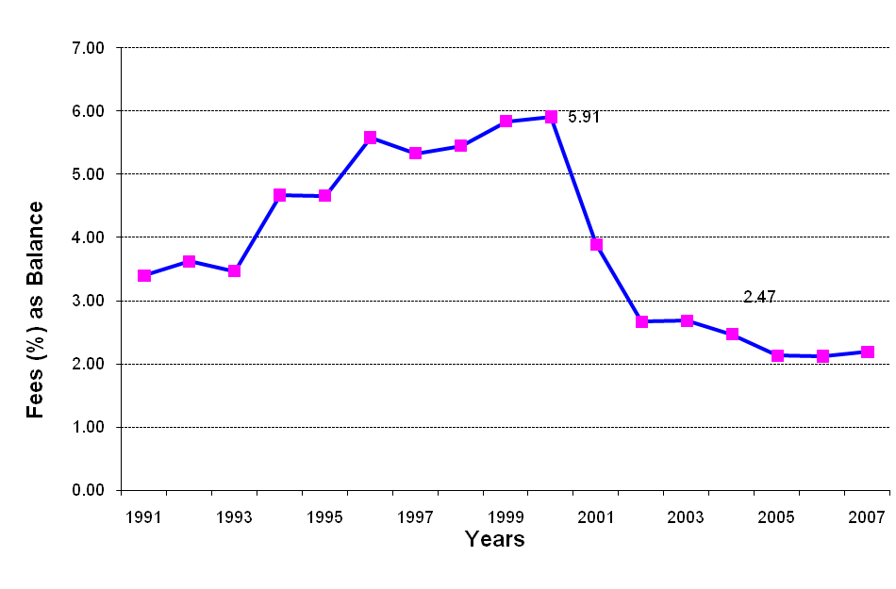
Time Pattern of Insurance Company Commissions (as front end % of balance)
Draft Law
Law Passed
28
Notes:
28

Slide 29

International Experience Singapore
Mandatory saving in accumulation accounts
Publicly administered Central Provident Fund set up in 1955
Regulated investment rules have constrained returns severely
CPF also provides subsidised insurance and loans (esp. housing)
Contributions compulsory up to maximum income
30% mandatory contribution, split equally between employer and employee
Notes:
Two-tier: senior government employees in unfunded DB system; $6000 month income maximum for compulsory contributions; contributions, income and capital gains, and withdrawals are exempt from income tax (rare). Total balances have stabilised at about 55% of GDP, a significant decline from 76% in 1986; CPF (at least the largest subcomponent fund) is obliged to invest in government securities (Singaporean); hence, annual real compound returns between 1987 and 1997 were roughly 0%.
Source: http://wbln0018.worldbank.org/HDNet/hddocs.nsf/0/58a20e0a641943e8852567d6007b63ae/$FILE/9919.pdf

Slide 30
Some points about Singapore
Accumulations not well preserved
Housing
Other drawdown possibilities
Health account not insurance
All publicly managed
Late life annuities being mandated

Slide 31
Principles and future trends
Two important ideas: portfolio allocation; late life bonus multiplier
Portfolio allocation
No reason to dramatically change asset allocation at the point of retirement
It should be a continuous process to balance human capital depletion
Late life coverage
Annuities give the best return if deferred to late life

Slide 32
The Survivor Bonus Multiplier
Annuities are most effective when used to fund consumption at older ages.
Assume 3% rate of return
Cost to 60 year old funding $100 consumption at age 100 = $100*1.03^(-40) = $31.
If instead the 60 year old buys an annuity making a single payment of $100 at age 100, then assuming a 2% probability of living to 100,
the cost is $100*1.03^(-40)*.02 = $0.62

Slide 33
Ruin contingent life annuities (RCLAs)
A deferred annuity which pays when
You live to a specified (old) age AND
The market performs poorly
Often linked with variable annuities
Could be offered as stand-alone
Captures both the above principles
Allocate most retirement wealth to a phased withdrawal, with discretionary asset allocation and drawdown
Exploit the mortality bonus multiplier

Slide 34
Other perspectives
Require annuitisation to remove access to social pension
Insist on consumption smoothing by requiring annuity purchase
Deductibles and risk sharing annuities
Investment
Inflation
Longevity risk and pooled annuity funds

Slide 35
Other concerns
Annuity markets thin everywhere:
Are solvency requirements too rigid?
Limited reinsurance market
Small number of swaps
Negligible securitisation
No longevity bonds
Distribution channels poor
Link retirement income purchase with DC funds?

Slide 36
Thank you
Questions?
John Piggott
j.piggott@unsw.edu.au

